Slide 1
Preliminary analysis results of metagenomic data
How to conceive a metagenomic data paper?
Jipeng Luo
Mar-4-2024
Bloomington, IN

Slide 2
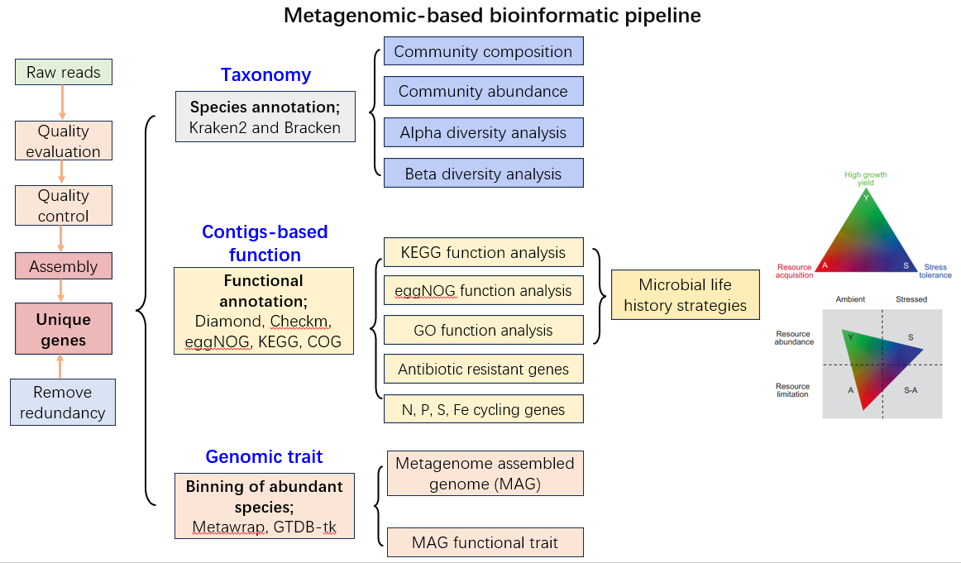

Slide 3
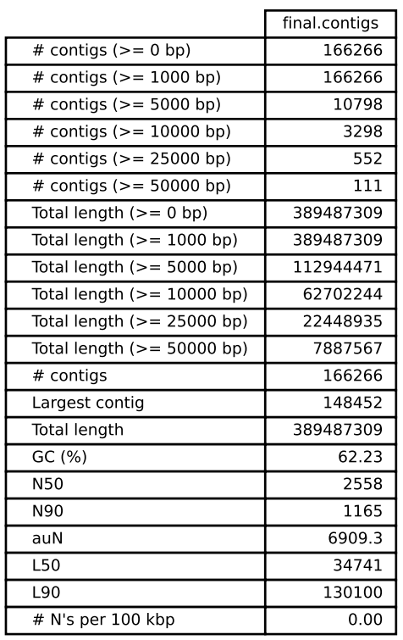
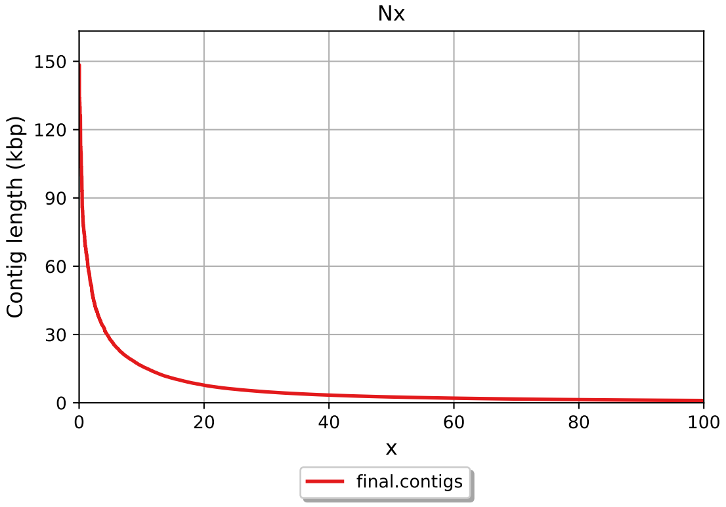
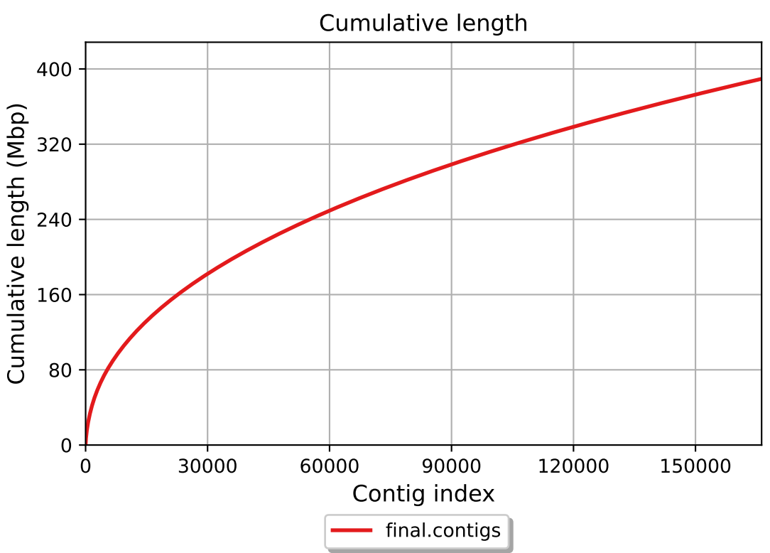
1. Quality evaluation of metagenomic reads
A contig is a set of DNA segments or sequences that overlap in a way that provides a contiguous representation of a genomic region.

Slide 4
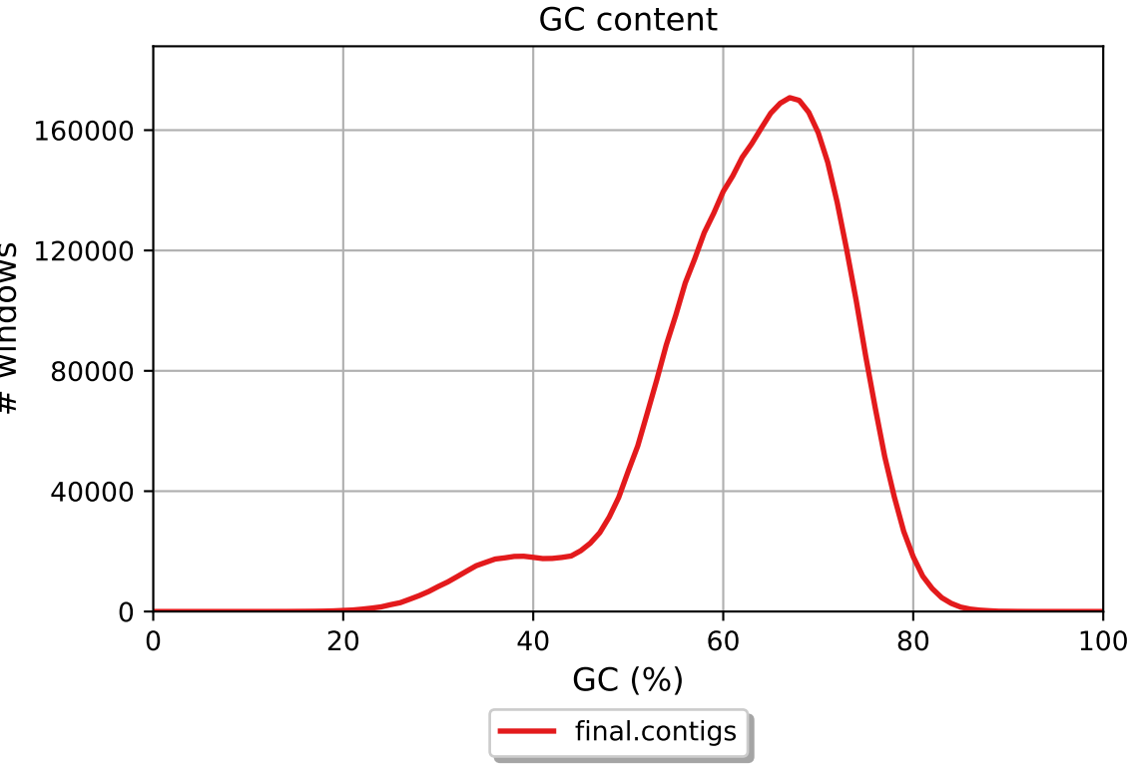
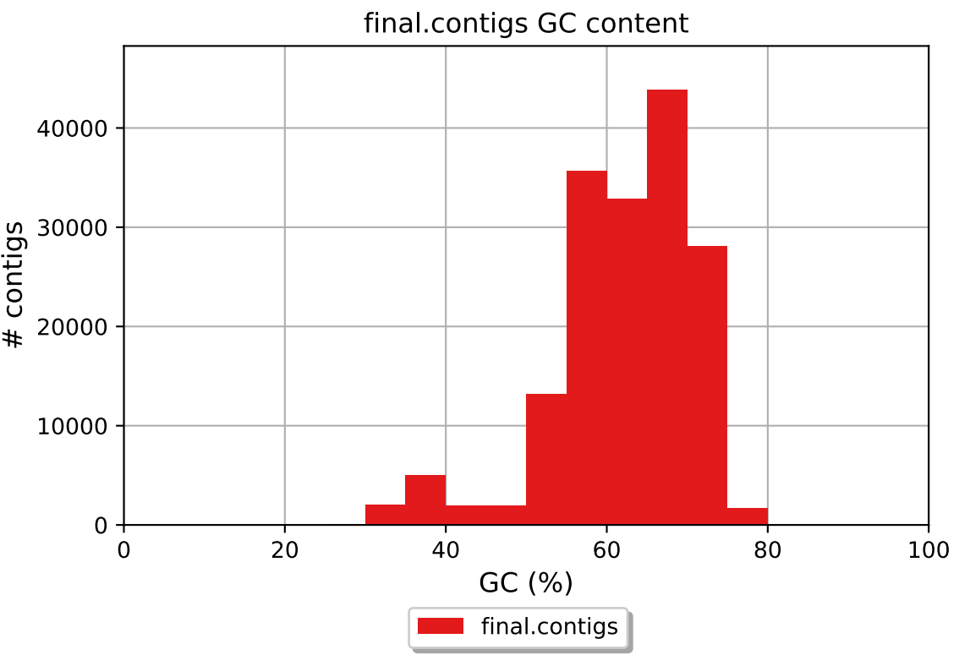
1. Quality evaluation of metagenomic reads
This batch of metagenomic sequences is of higher quality and can reflect biological processes.

Slide 5
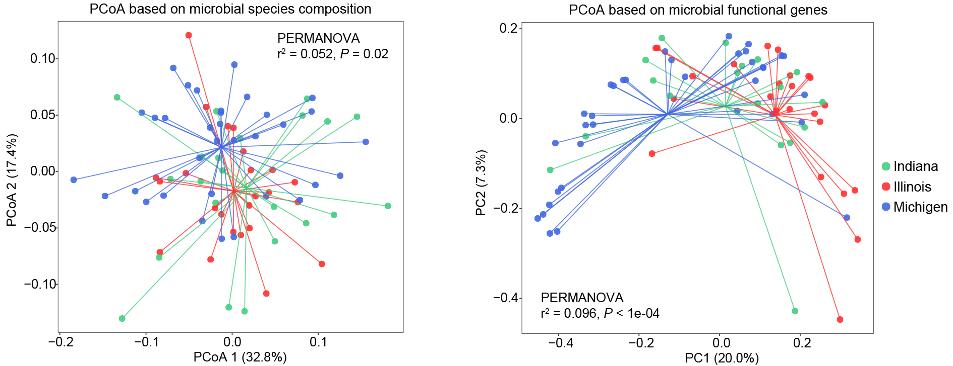
2. Microbial community taxonomic and functional compositions across the three states
Functional gene composition varies to a larger degree across the three states than species composition.
Microbial taxonomic and functional compositions from IN and IL clusters more closely than that from MI.

Slide 6
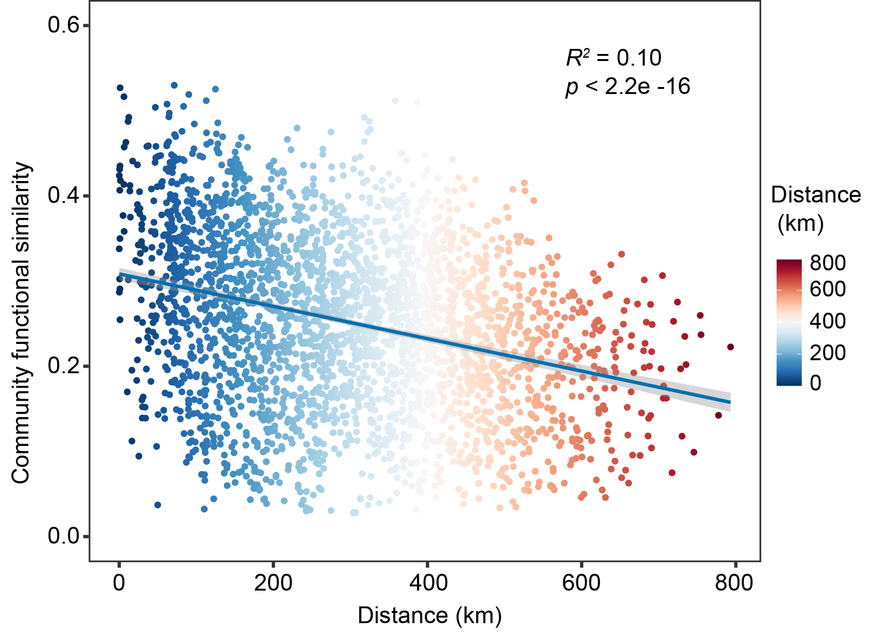
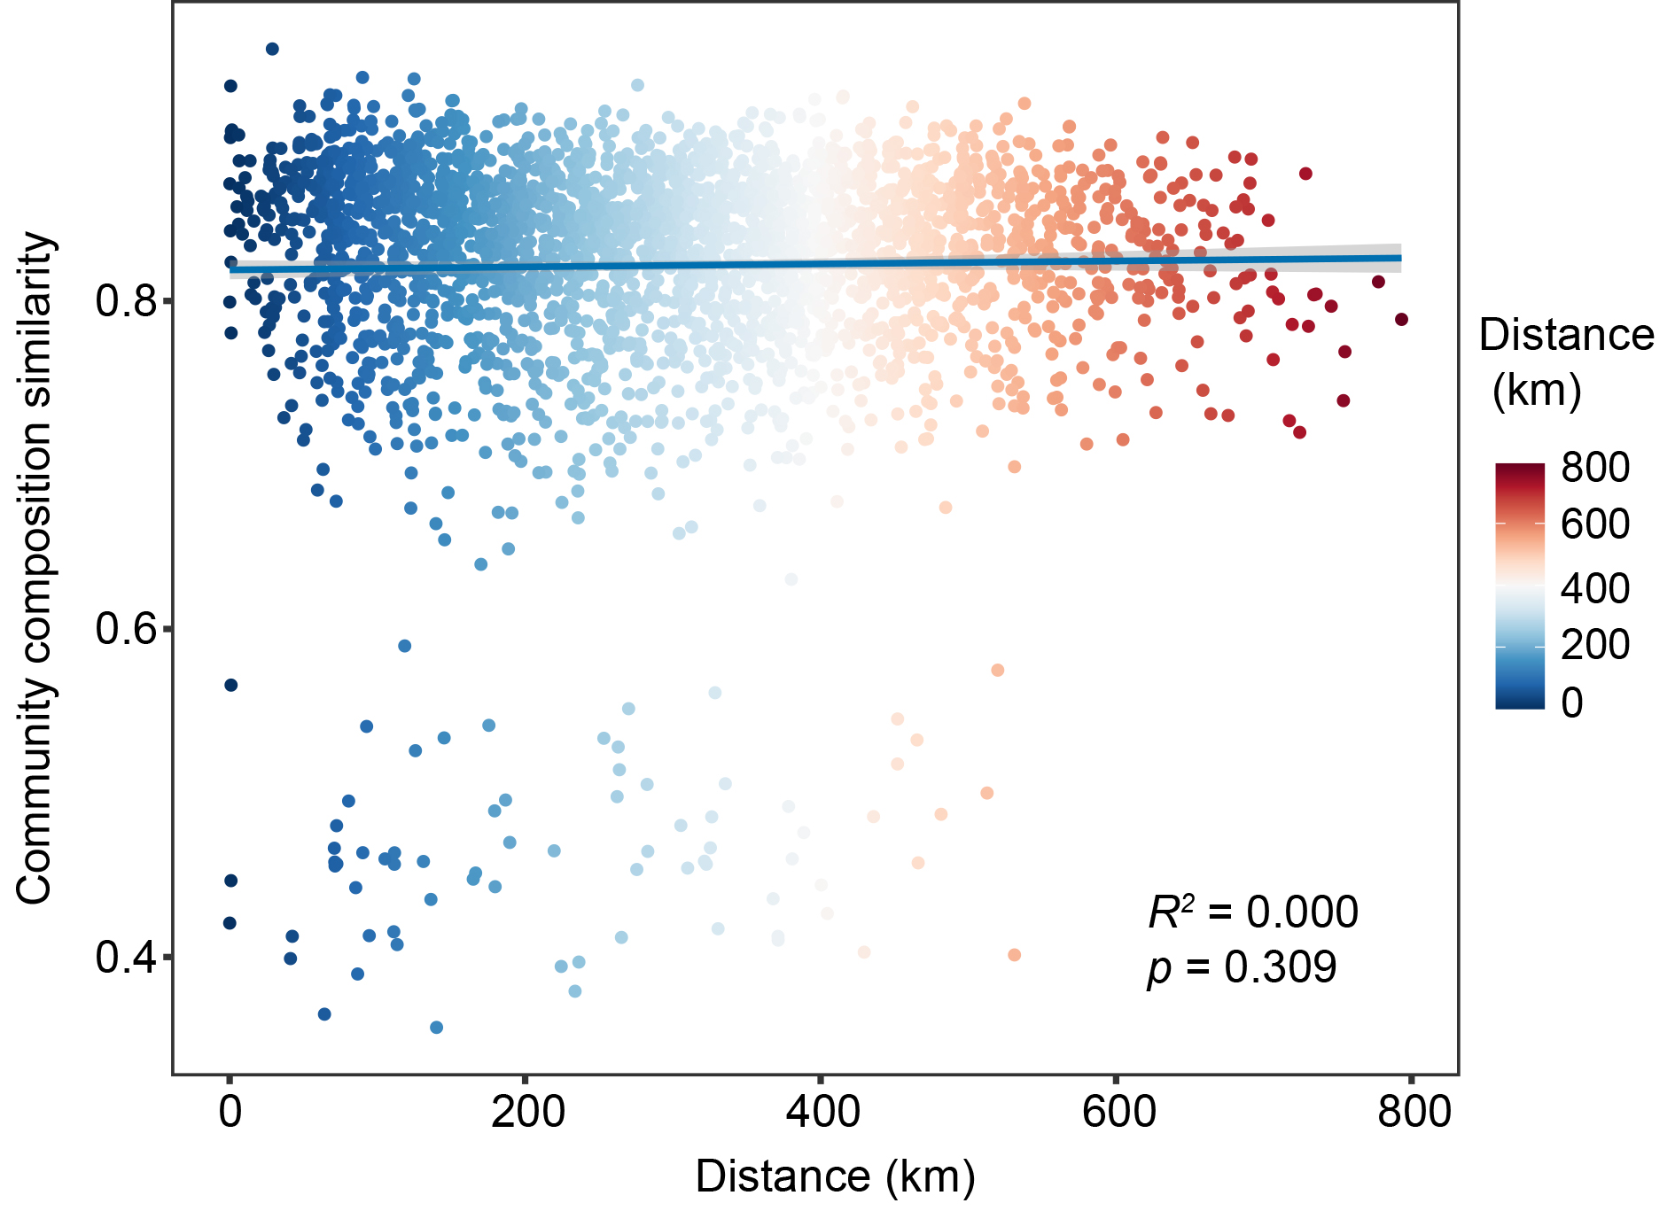
Distance-decay model relationships among functional genes
Distance-decay model relationships among microbial communities
The left figure shows that microbial functional genes significantly decrease with the increasing geographic distance, which could be due to differences in land management, drought history and climatic variables. But this was not the case for microbial communities that carry the functional genes.
Notes:
The left figure shows that microbial functional genes significantly decrease with the increasing geographic distance, which could be due to differences in land management, drought history and climatic variables. But this was not the case for microbial communities that carry the functional genes.
The distance decay model of microbiome function and composition demonstrates asynchronous changes with increasing geographic distance, which may indicate decoupling between community function and structure.
The functional similarity of microbiome is ~30% when the distance is close, and decreases to ~18% when is furthest.
But when we look at the right figure, it appears that there is a lot of similarity (~80%) among samples, even at really far geographic distances. This seems a bit strange.

Slide 7
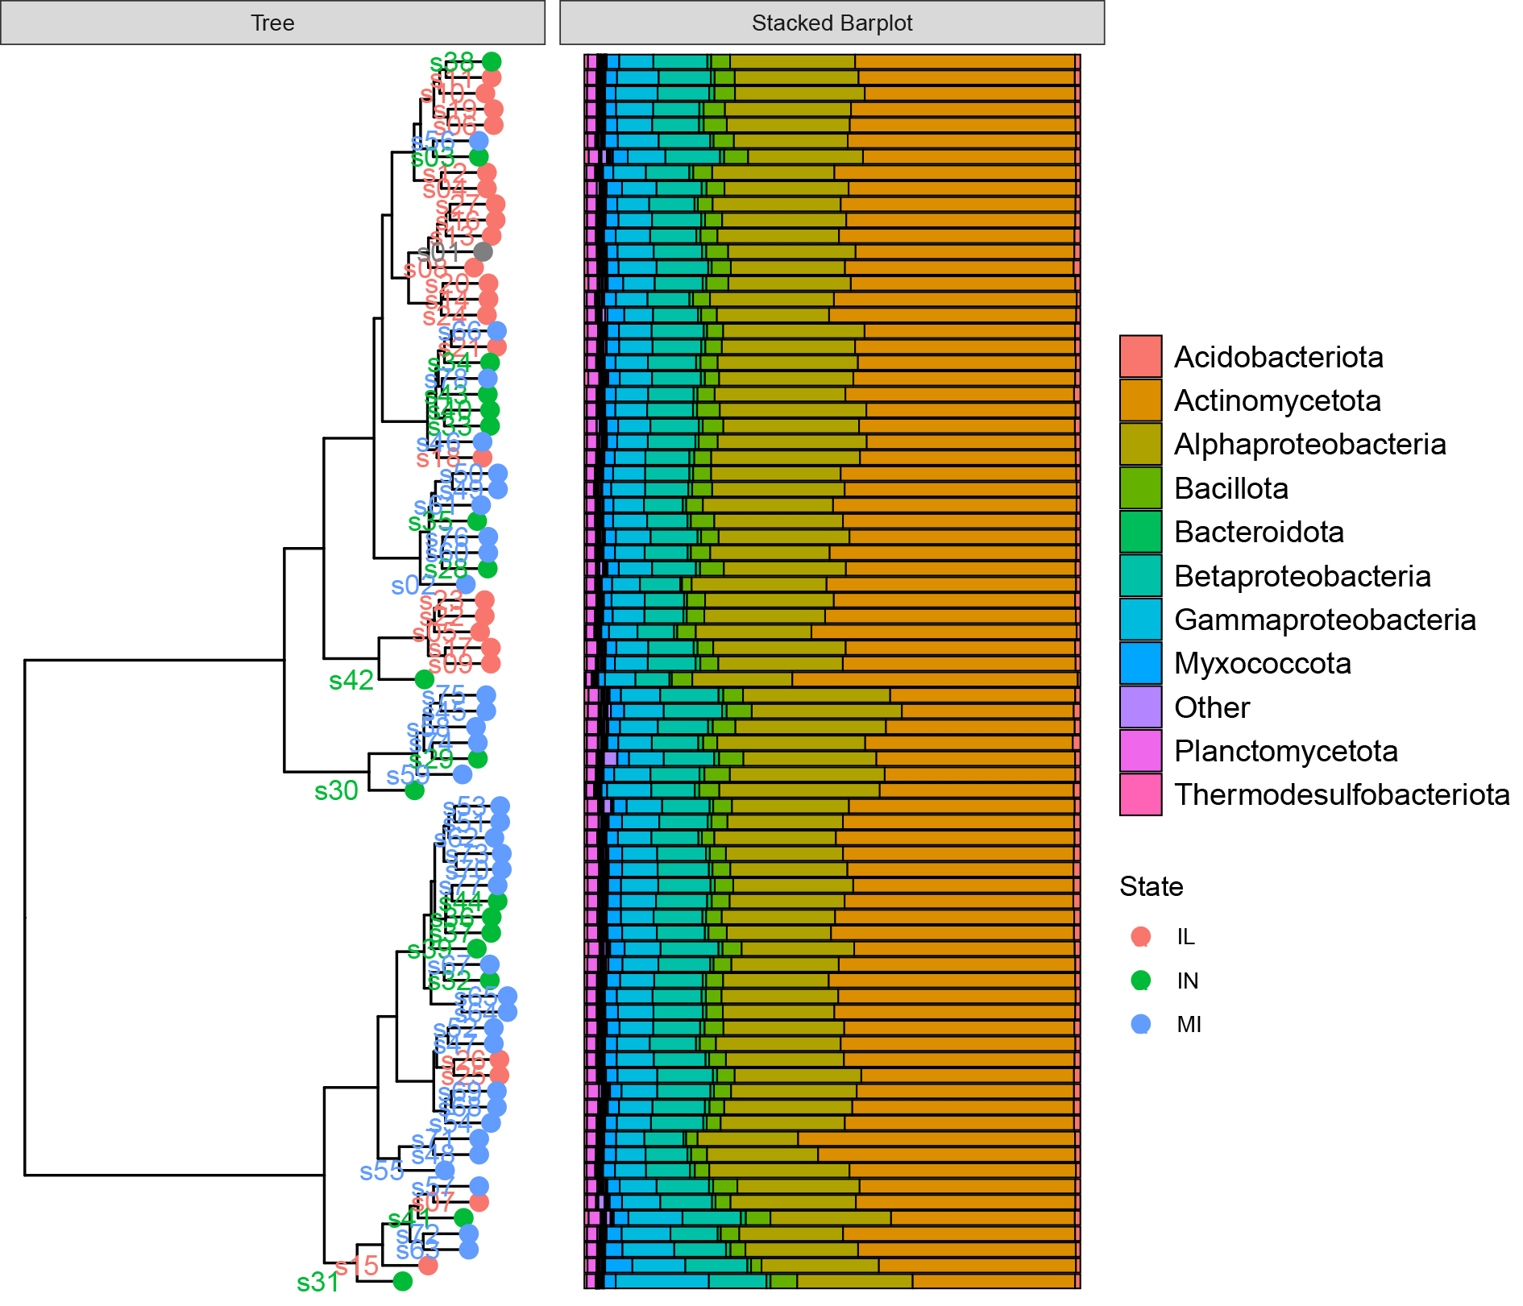
3. Microbial community taxonomic structures across the samples collected from three states
The top ten most abundant bacterial sub-phylum

Slide 8
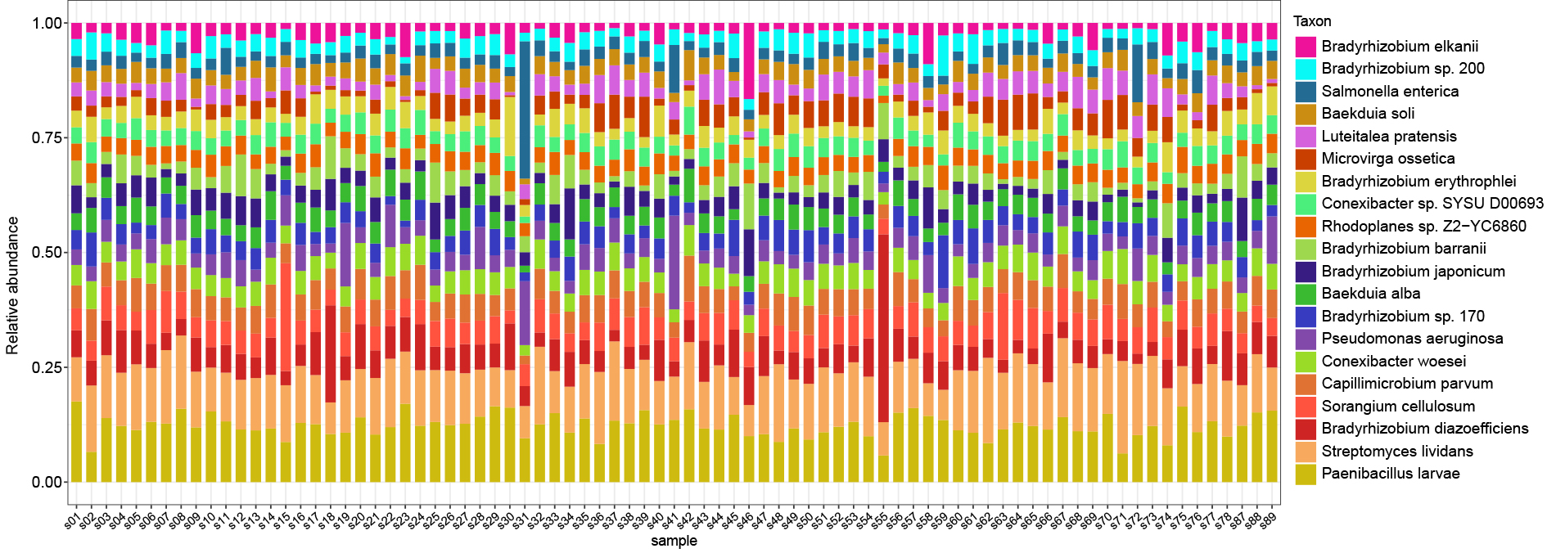
The top 20 most abundant bacterial species

Slide 9
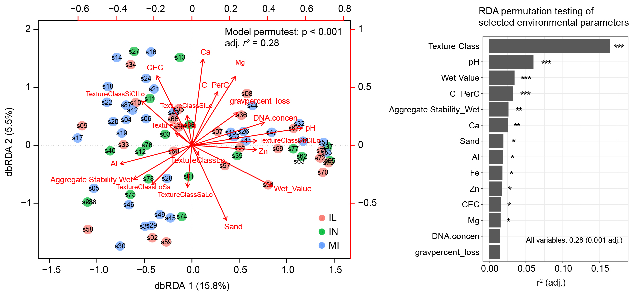
4. Relationships between community functional composition and selected environmental parameters
Distance-based RDA and the importance of selected parameters
Notes:
We used dbRDA to explore the relationship between microbial functional gene composition and selected environmental parameters. We step through all combinations of explanatory variables in our model, the function returns the model with the lowest AIC value.

Slide 10
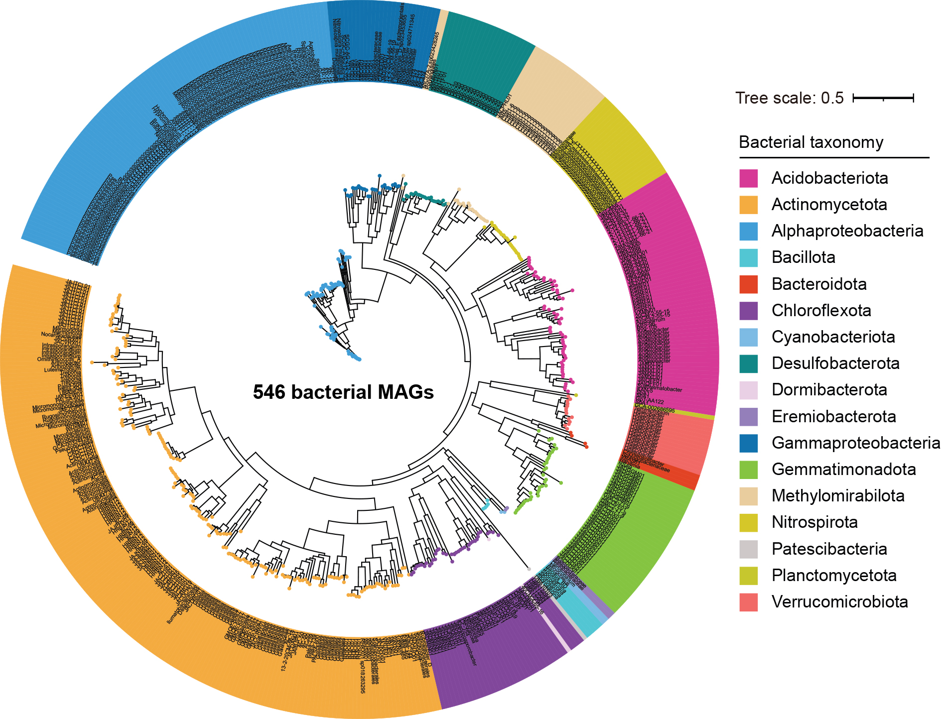
5. Metagenome-assembled genomes (MAGs)
A total of 546 high-quality MAGs were identified (completeness > 50%, contamination < 10%).
MAGs represent abundant microbial species in soils, and are ideal targets used for exploit functional traits that play critical roles in their habitat.

Slide 11
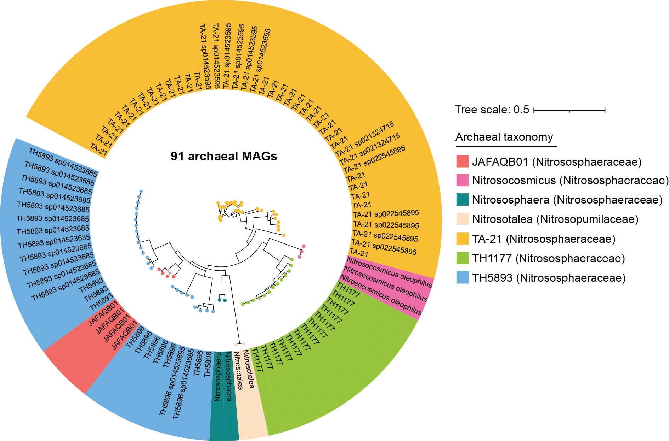
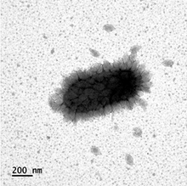
A total of 91 high-quality MAGs were identified (mean completeness > 75%, contamination < 10%).
All MAGs belong to Nitrososphaeria, with 89 MAGs affiliated with Nitrosophaeraceae and two with Nitrosopumilaceae.
Nitrososphaeria contain a diversity of mesophilic genus of ammonia-oxidizing Crenarchaeota.
The Nitrososphaera genus contains one of the first discovered ammonia-oxidizing archaea (N. viennensis).

Slide 12
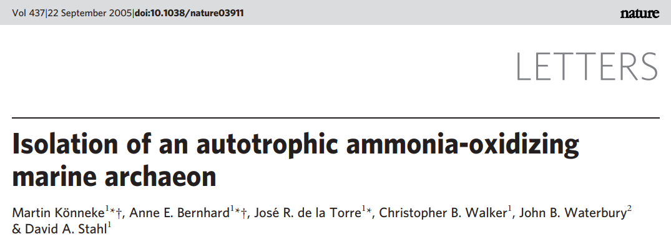
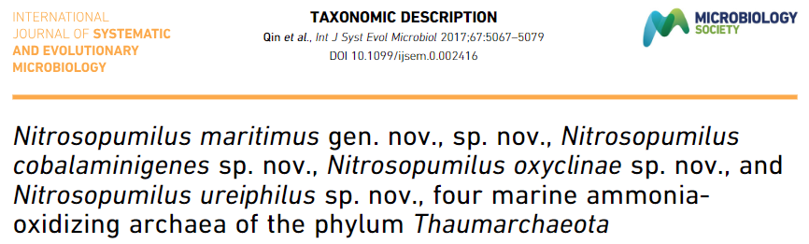
The discovery of Nitrososphaera capable of ammonia oxidation indicated that both archaea and bacteria were capable of ammonia oxidation.
Ammonia-oxidizing archaea and ammonia-oxidizing bacteria work together in the nitrogen cycle. Ammonia-oxidizing archaea, including Nitrososphaera, are abundant in warm and humid soils, along with ammonia-oxidizing bacteria. Both microbes play a significant role in the nitrification of soils.
It seems that the soils from IL, IN, MI harbor a diversity of nitrifying archaea that drive soil nitrification.

Slide 13
6. Next steps and works
To identify the differences in genomic functional traits, and functional genes within MAGs between treatments, and also examine their linkages with environmental variables, yield and even ecosystem functions.
What would a stand alone metagenomics paper look like? To fit in with proposal, we would be wanting to investigate some drought related response from the survey.
Can the metagenomics data be used to help explain some of the variance in microbe-mediated corn responses to drought in Mia’s experiment?

